Slide 1
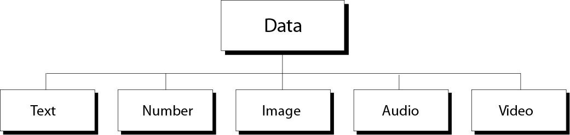
Chapter 3
Number
Representation

Slide 2
OBJECTIVES
After reading this chapter, the reader should be able to :
Convert a number from decimal、hexadecimal,octal to
binary notation and vice versa.
Understand the different representations of an integer inside a computer: unsigned, sign-and-magnitude, one’s complement, and two’s complement.
Understand the Excess system(阶码) that is used to store the exponential part of a floating-point number.
Understand how floating numbers are stored inside a computer using the exponent(指数) and the mantissa (尾数).

Slide 3
Contents
3.1 Decimal and Binary
3.2 Conversion
3.3 Hexadecimal
3.4 Octal
3.5 Integer representation
3.6 Excess System
3.7 Floating-Point Representation

Slide 4
3.1
DECIMAL
AND
BINARY

Slide 5
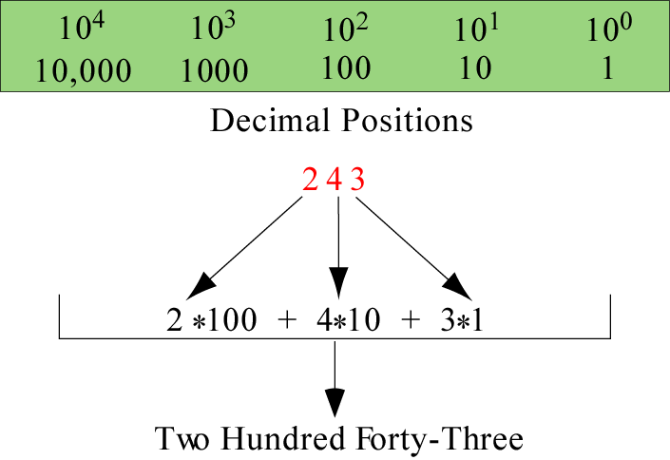
Decimal system
Figure 3-1
243=2×10²+4 × 10¹+3 × 10⁰
basis
position value:weight

Slide 6
Decimal system
weight
…, 100, 10, 1, 1/10, 1/100, …
…, 10², 10¹, 10⁰ , 10⁻¹, 10⁻² , …
DN = C_{n}10^{n}+…+C₂10²+C₁10¹+ C₀ 10⁰ + C₋₁10⁻¹ + C₋₂10⁻² +…+C_{-m}10^{-m}
C = 0~9

Slide 7
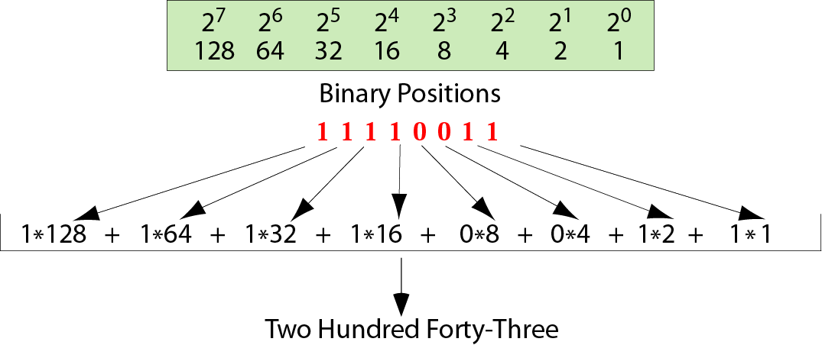
Figure 3-2
Binary system
(11110011)₂=1×2⁷+1 ×2⁶+1 × 2⁵ + 1×2⁴+1 ×2¹+1 × 2⁰

Slide 8
Binary system
weight
…,128, 64, 32, 16, 8, 4, 2, 1, 1/2, 1/4, 1/8…
…,2⁷, 2⁶, 2⁵, 2⁴, 2³ , 2² , 2¹, 2⁰, 2⁻¹, 2⁻², 2⁻³, ...
BN = C_{n}2^{n}+…+C₂2²+C₁2¹+ C₀ 2⁰ + C₋₁2⁻¹ + C₋₂2⁻² +…+C_{-m}2^{-m}
C = 0 or 1

Slide 9
3.2
CONVERSION
二 ←→十

Slide 10
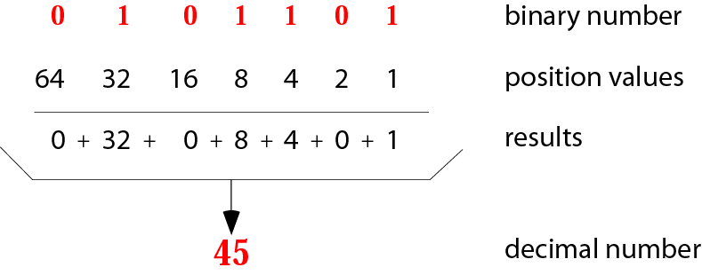
Figure 3-3
Binary to Decimal Conversion

Slide 11
Example 1
Convert the binary number 10011 to decimal.
Solution
Write out the bits and their weights. Multiply the bit by its corresponding weight and record the result. At the end, add the results to get the decimal number.
Binary 1 0 0 1 1
Weights 16 8 4 2 1
-------------------------------------
16 + 0 + 0 + 2 + 1
Decimal 19

Slide 12
Convert the binary number 1001.101 to decimal.
Solution
(1001.101)₂
=1×2³+0×2²+0×2¹+1×2⁰+1×2⁻¹
+0×2⁻²+1×2⁻³
=8+1+0.5+0.125
=(9.625)₁₀

Slide 13
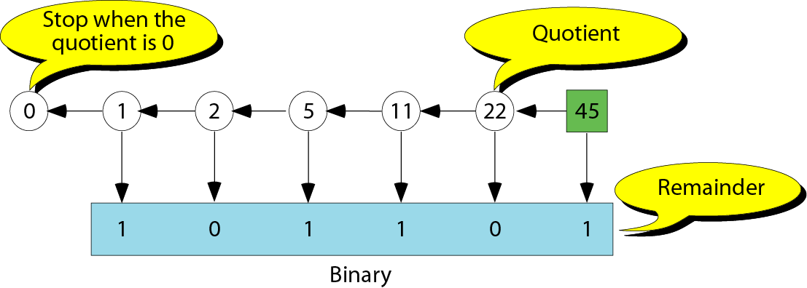
Decimal to Binary Conversion---Integer part
BN = C_{n}2^{n}+…+C₂2²+C₁2¹+ C₀ 2⁰ + C₋₁2⁻¹ + C₋₂2⁻² +…+C_{-m}2^{-m}
C ₅
C ₄
C ₃
C ₂
C ₁
C ₀
除2取余

Slide 14
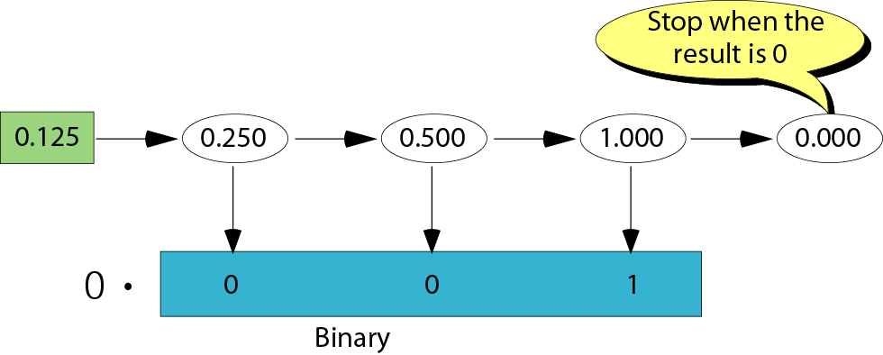
Decimal to binary conversion---Fraction part
BN = C_{n}2^{n}+…+C₂2²+C₁2¹+ C₀ 2⁰ + C₋₁2⁻¹ + C₋₂2⁻² +…+C_{-m}2^{-m}
C ₋₁
C₋₂
C ₋₃
乘2取整

Slide 15
Example 2
Convert the decimal number 35 to binary.
Solution
Write out the number at the right corner. Divide the number continuously by 2 and write the quotient and the remainder. The quotients move to the left, and the remainder is recorded under each quotient. Stop when the quotient is zero.
0 ⬅ 1 ⬅ 2 ⬅ 4 ⬅ 8 ⬅ 17 ⬅ 35 Dec.
Binary 1 0 0 0 1 1
(35)₁₀ = (100011)₂

Slide 16
3.3
HEXADECIMAL
NOTATION

Slide 17

Note:
A 4-bit pattern can be represented
by a hexadecimal digit,
and vice versa.

Slide 18
Table 2.2 Hexadecimal digits
Bit Pattern
------------
0000
0001
0010
0011
0100
0101
0110
0111
Hex
Digit
------------
0
1
2
3
4
5
6
7
Bit Pattern
------------
1000
1001
1010
1011
1100
1101
1110
1111
Hex
Digit
------------
8
9
A
B
C
D
E
F

Slide 19
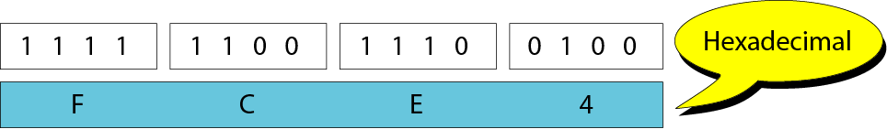
Figure 2-10
Binary to hexadecimal and
hexadecimal to binary transformation

Slide 20
Example 1
Show the hexadecimal equivalent of the bit pattern 1100 1110 0010.
Solution
Each group of 4 bits is translated to one hexadecimal digit. The equivalent is xCE2.

Slide 21
Example 2
Show the hexadecimal equivalent of the bit pattern 0011100010.
Solution
Divide the bit pattern into 4-bit groups (from the right). In this case, add two extra 0s at the left to make the number of bits divisible by 4. So you have 000011100010, which is translated to x0E2.

Slide 22
Example 3
What is the bit pattern for x24C?
Solution
Write each hexadecimal digit as its equivalent bit pattern to get
001001001100.

Slide 23
Example ?
Show the hexadecimal equivalent of the bit pattern （11000011.10101)₂ .
Solution
1100 0011. 1010 1000
C 3. A 8
(11000011.10101)₂=(C3.A8)₁₆

Slide 24
Example ?
What is the bit pattern for （8B.C4)_{16?}
Solution
8 B . C 4
1000 1011. 1100 0100
(8B.C4)₁₆ ＝(10001011.110001)₂

Slide 25
3.4
OCTAL
NOTATION

Slide 26
Note:
A 3-bit pattern can be represented
by an octal digit, and vice versa.

Slide 27
Table 3.3 Octal digits
Bit Pattern
------------
000
001
010
011
Oct Digit
------------
0
1
2
3
Bit Pattern
------------
100
101
110
111
Oct Digit
------------
4
5
6
7

Slide 28
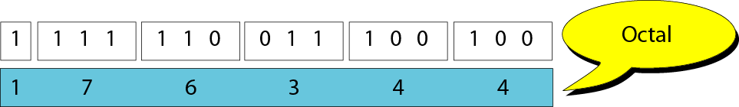
Figure 2-11
Binary to octal and
octal to binary transformation

Slide 29
Example 4
Show the octal equivalent of the bit pattern
101110010.
Solution
Each group of 3 bits is translated to one octal digit. The equivalent is 0562,
o562, or 562₈.

Slide 30
Example 5
Show the octal equivalent of the bit pattern
1100010.
Solution
Divide the bit pattern into 3-bit groups (from the right). In this case, add two extra 0s at the left to make the number of bits divisible by 3. So you have 001100010, which is translated to 142₈.

Slide 31
Example 6
What is the bit pattern for 24₈?
Solution
Write each octal digit as its equivalent bit pattern to get 010100.

Slide 32
Example ?
Show the hexadecimal equivalent of the bit pattern (11110100.1110111)₂ .
Solution
011 110 100 . 111 011 100
3 6 4 . 7 3 4
(11110100.1110111)₂=(364.734)₈

Slide 33
Example ?
What is the bit pattern for （351.65）₈ ?
Solution
3 5 1. 6 5
011 101 001. 110 101
(351.65)₈＝(11101001.110101)₂

Slide 34
3.5
INTEGER
REPRESENTATION

Slide 35
Figure 3-5
Range of integers
negative integer
positive integer

Slide 36
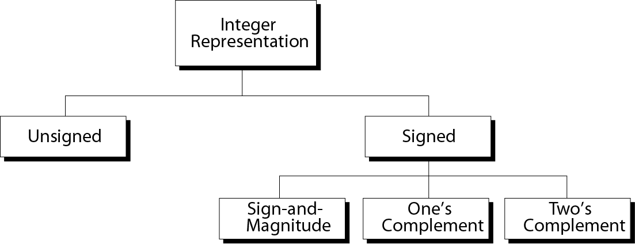
Figure 3-6
Taxonomy(分类) of integers

Slide 37
Unsigned Integers Format(无符号整数)
Most computers define a constant called the maximum unsigned integer.
Ranger: 0~ (2^{N}-1)
Table 3.1 Range of unsigned integers
Number of Bits
---------
8
16
Range
-------------------------------------
0 255
0 65,535

Slide 38
Representation(表示法):
1.The number is changed to binary;
2.if the number of bits is less than N, 0s are added to the left of the binary number so that there is a total of N bits.

Slide 39
Example 3
Store 7 in an 8-bit memory location.
Solution
First change the number to binary 111. Add five 0s to make a total of N (8) bits, 00000111. The number is stored in the memory location.

Slide 40
Example 4
Store 258 in a 16-bit memory location.
Solution
First change the number to binary 100000010. Add seven 0s to make a total of N (16) bits, 0000000100000010. The number is stored in the memory location.

Slide 41
Table 3.2 Example of storing unsigned integers in
two different computers
Decimal
-----------
7
234
258
24,760
1,245,678
8-bit allocation
------------
00000111
11101010
overflow
overflow
overflow
16-bit allocation
---------------------------
0000000000000111
0000000011101010
0000000100000010
0110000010111000
overflow

Slide 42
Example 5
Interpret 00101011 in decimal if the number was stored as an unsigned integer.
Solution
Using the procedure shown in Figure 3.3 , the number in decimal is 43.

Slide 43
Application:
1.Counting;
2.Addressing.

Slide 44
Sign-and-magnitude Format(原码)
We need 1 bit to represent the sign(0 for positive, 1 for negative).
The maximum positive value is one half the unsigned value.
Ranger: -(2 ^{N-1}-1)~ +(2^{N-1}-1)
原码表示

Slide 45
Note:
There are two 0s in sign-and-magnitude
representation: positive and negative.
In an 8-bit allocation:
+0 ➔ 00000000
-0 ➔ 10000000

Slide 46
Table 3.3 Range of sign-and-magnitude integers
# of Bits
----------
8
16
32
Range
-------------------------------------------------------
−127 −0
−32767 −0
−2,147,483,647 −0
+0 +127
+0 +32767
+0 +2,147,483,647

Slide 47
Representation:（表示---从真值到原码）
1.The number is changed to binary;the sign is ignored
2.if the number of bits is less than N-1, 0s are added to the left of the binary number so that there is a total of N-1 bits.
3.If the number is positive, 0 is added to the left. If the number is negative, 1 is added to the left.

Slide 48
Note:
In sign-and-magnitude representation,
the leftmost bit defines the sign of the number. If it is 0, the number is positive.If it is 1, the number is negative.

Slide 49
Example 6
Store +7 in an 8-bit memory location using sign-and-magnitude representation.
Solution
First change the number to binary 111. Add four 0s to make a total of N-1 (7) bits, 0000111. Add an extra zero because the number is positive. The result is:
00000111

Slide 50
Example 7
Store –258 in a 16-bit memory location using sign-and-magnitude representation.
Solution
First change the number to binary 100000010. Add six 0s to make a total of N-1 (15) bits, 000000100000010. Add an extra 1 because the number is negative. The result is:
1000000100000010

Slide 51
Table 3.4 Example of storing sign-and-magnitude integers
in two computers
Decimal
-----------
+7
-124
+258
-24,760
8-bit allocation
------------
00000111
11111100
overflow
overflow
16-bit allocation
---------------------------
0000000000000111
1000000001111100
0000000100000010
1110000010111000

Slide 52
Interpretation:(解释，翻译---从原码到真值)
1.Ignore the first bit.
2.Change the N-1 bits form binary to decimal as shown at the beginning of the chapter..
3.Attach a + or a – sign to the number based on the leftmost bit..

Slide 53
Example 8
Interpret 10111011 in decimal if the number was stored as a sign-and-magnitude integer.
Solution
Ignoring the leftmost bit, the remaining bits are 0111011. This number in decimal is 59. The leftmost bit is 1, so the number is –59.

Slide 54
One’s Complement Format(反码)
To represent a positive number, use the convention adopted for an unsigned integer.
To represent a negative number, complement the positive number.
Ranger: -(2 ^{N-1}-1)~ +(2^{N-1}-1)

Slide 55
Note:
There are two 0s in one’s complement
representation: positive and negative.
In an 8-bit allocation:
+0 ➔ 00000000
-0 ➔ 11111111

Slide 56
Table 3.5 Range of one’s complement integers
# of Bits
---------
8
16
32
Range
-------------------------------------------------------
−127 −0
−32767 −0
−2,147,483,647 −0
+0 +127
+0 +32767
+0 +2,147,483,647

Slide 57
Representation: （表示---从真值到反码）
1.The number is changed to binary;the sign is ignored
2.0s are added to the left of the number to make a total of N bits.
3.If the sign is positive, no more action is needed. If the sign is negative, every bit is complemented(changed form 0 to 1 and 1 to 0).

Slide 58
Note:
In one’s complement representation,
the leftmost bit defines the sign of the number. If it is 0, the number is positive.If it is 1, the number is negative.

Slide 59
Example 9
Store +7 in an 8-bit memory location using one’s complement representation.
Solution
First change the number to binary 111. Add five 0s to make a total of N (8) bits, 00000111. The sign is positive, so no more action is needed. The result is:
00000111

Slide 60
Example 10
Store –258 in a 16-bit memory location using one’s complement representation.
Solution
First change the number to binary 100000010. Add seven 0s to make a total of N (16) bits, 0000000100000010. The sign is negative, so each bit is complemented. The result is:
1111111011111101

Slide 61
Table 3.6 Example of storing one’s complement integers in
two different computers
Decimal
----------
+7
−7
+124
−124
+24,760
−24,760
8-bit allocation
------------
00000111
11111000
01111100
10000011
overflow
overflow
16-bit allocation
---------------------------
0000000000000111
1111111111111000
0000000001111100
1111111110000011
0110000010111000
1001111101000111

Slide 62
Interpretation:(解释，翻译---从反码到真值)
1. If the leftmost bit is 0
a.Change the entire number from binary to decimal.
b.Put a + in front of the number.
2. If the leftmost bit is 1
a.Complement the entire number .
b.Change the entire number from binary to decimal.
c.Put a - in front of the number.

Slide 63
Example 11
Interpret 11110110 in decimal if the number was stored as a one’s complement integer.
Solution
The leftmost bit is 1, so the number is negative. First complement it . The result is 00001001. The complement in decimal is 9. So the original number was –9.

Slide 64
Note:
One’s complement means reversing all bits. If you one’s complement a positive number, you get the corresponding negative number. If you one’s complement a negative number, you get the corresponding positive number. If you one’s complement a number twice, you get the original number.

Slide 65
Two’s Complement Format(补码)
Note:
Two’s complement is the most common, the most important, and the most widely used representation of integers today.
Ranger: -(2 ^{N-1})~ +(2^{N-1}-1)

Slide 66
Table 3.7 Range of two’s complement integers
# of Bits
---------
8
16
32
Range
-------------------------------------------------------
−128
−32,768
−2,147,483,648
0 +127
0 +32,767
0 +2,147,483,647

Slide 67
Representation: （表示---从真值到补码）
1.The number is changed to binary;the sign is ignored
2.0s are added to the left of the number to make a total of N bits.
3. If the sign is positive, no more action is needed.
4. If the sign is negative, leave all the rightmost 0s and the first 1 unchanged. Complement the rest of the bits.

Slide 68
Note:
In two’s complement representation,
the leftmost bit defines the sign of the number. If it is 0, the number is positive.
If it is 1, the number is negative.

Slide 69
Example 12
Store +7 in an 8-bit memory location using two’s complement representation.
Solution
First change the number to binary 111. Add five 0s to make a total of N (8) bits, 00000111.The sign is positive, so no more action is needed. The result is:
00000111

Slide 70
Example 13
Store –40 in a 16-bit memory location using two’s complement representation.
Solution
First change the number to binary 101000. Add ten 0s to make a total of N (16) bits, 0000000000101000. The sign is negative, so leave the rightmost 0s up to the first 1 (including the 1) unchanged and complement the rest. The result is:
1111111111011000

Slide 71
Table 3.8 Example of storing two’s complement integers in
two different computers
Decimal
-----------
+7
−7
+124
−124
+24,760
−24,760
8-bit allocation
------------
00000111
11111001
01111100
10000100
overflow
overflow
16-bit allocation
---------------------------
0000000000000111
1111111111111001
0000000001111100
1111111110000100
0110000010111000
1001111101001000

Slide 72
Note:
There is only one 0 in two’s complement:
In an 8-bit allocation:
0 ➔ 00000000

Slide 73
Interpretation :(解释，翻译---从补码到真值)
1. If the leftmost bit is 0, Change the entire number from binary to decimal,Put a + in front of the number.
2. If the leftmost bit is 1
a.Leave the rightmost bits up to the first 1(inclusive) unchanged. Complement the rest of the bits.
b.Change the whole number from binary to decimal.
c.Put a - in front of the number.

Slide 74
Example 14
Interpret 11110110 in decimal if the number was stored as a two’s complement integer.
Solution
The leftmost bit is 1. The number is negative. Leave 10 at the right alone and complement the rest. The result is 00001010. The two’s complement number is 10. So the original number was –10.

Slide 75
Note:
Two’s complement can be achieved by reversing all bits except the rightmost bits up to the first 1 (inclusive). If you two’s complement a positive number, you get the corresponding negative number. If you two’s complement a negative number, you get the corresponding positive number. If you two’s complement a number twice, you get the original number.

Slide 76
Table 3.9 Summary of integer representation
Contents of Memory
0000
0001
0010
0011
0100
0101
0110
0111
1000
1001
1010
1011
1100
1101
1110
1111
Unsigned
0
1
2
3
4
5
6
7
8
9
10
11
12
13
14
15
Sign-and-Magnitude
+0
+1
+2
+3
+4
+5
+6
+7
−0
−1
−2
−3
−4
−5
−6
−7
One’s
Complement
+0
+1
+2
+3
+4
+5
+6
+7
−7
−6
−5
−4
−3
−2
−1
−0
Two’s
Complement
+0
+1
+2
+3
+4
+5
+6
+7
−8
−7
−6
−5
−4
−3
−2
−1

Slide 77
3.6
EXCESS
SYSTEM

Slide 78
Excess System
Representation(表示---从真值到阶码)
1.Add the magic number(幻数 ) to the integer.
2.Change the result to binary and add 0s so that there is a total of N bits.
Interpretation(表示---从阶码到真值)
1.Change the number to decimal;
2.Subtract the magic number from the integer.
N=8, range -127~ +128 , -(2^{N-1} -1) ~ 2^{N-1}

Slide 79
Example 15
Represent –25 in Excess_127 using an 8-bit allocation.
Solution
First add 127 to get 102. This number in binary is 1100110. Add one bit to make it 8 bits in length. The representation is 01100110.

Slide 80
Example 16
Interpret 11111110 if the representation is Excess_127.
Solution
First change the number to decimal. It is 254. Then subtract 127 from the number. The result is decimal 127.

Slide 81
3.7
FLOATING-POINT
REPRESENTATION

Slide 82
Floating-Point representation
To represent a floating-point number(a number containing an integer and a fraction),the number is divided into two parts:the integer and the fraction.
For example:
A Floating-point number 14.234
Integer:14
Fraction:0.234

Slide 83
Floating-Point representation
To convert a floating-point number to binary:
1.Convert the integer part to binary( Unsigned Integers Format).
2.Convert the fraction part to binary.
3.Put a decimal point between the two parts.

Slide 84
Figure 3-7
Changing fractions to binary

Slide 85
Example 17
Transform the fraction 0.875 to binary
Solution
Write the fraction at the left corner. Multiply the number continuously by 2 and extract the integer part as the binary digit. Stop when the number is 0.0.
0.875 ➔ 1.750 ➔ 1.5 ➔ 1.0 ➔ 0.0
0 . 1 1 1

Slide 86
Example 18
Transform the fraction 0.4 to a binary of 6 bits.
Solution
Write the fraction at the left cornet. Multiply the number continuously by 2 and extract the integer part as the binary digit. You can never get the exact binary representation. Stop when you have 6 bits.
0.4 ➔ 0.8 ➔ 1.6 ➔ 1.2 ➔ 0.4 ➔ 0.8 ➔ 1.6
0 . 0 1 1 0 0 1

Slide 87
Normalization
To present the number 1101.1101(13.8125)
2³× 1.1011101 or
2⁵× .011011101 or
2⁻⁴× 11011101.
Note
Normalization:Moving the decimal point so that there is only one 1 to the left of the decimal point.

Slide 88
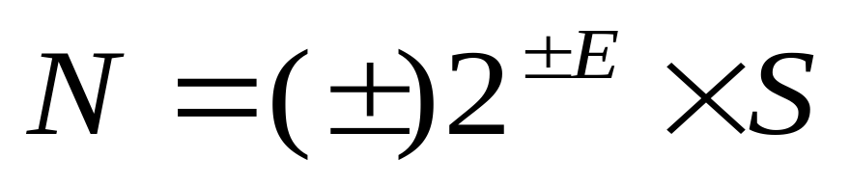
Table 3.10 Example of normalization
Original Number
------------
+1010001.1101
−111.000011
+0.00000111001
−0.001110011
Move
------------
⬅ 6
⬅ 2
6 ➔
3 ➔
Normalized
------------
+2⁶ x 1.01000111001
−2² x 1.11000011
+2⁻⁶ x 1.11001
−2⁻³ x 1.110011

Slide 89
Sign,Exponent and Mantissa
For example:
A number +1000111.0101 is Normalized, it becomes,
+ 2⁶ × 1.0001110101
sign + exponent 6 mantissa 0001110101

Slide 90
Sign,Exponent and Mantissa
Sign:The sign of the number can be stored using 1bit(0 or 1).
Exponent:The exponent defines the movement of the decimal point. Note that the power can be negative of positive.
EXCESS representation is the method used to store the exponent.
Mantissa:is the binary number to the right of the decimal point. It defines the precision of the number. It is stored as an unsigned integer.

Slide 91
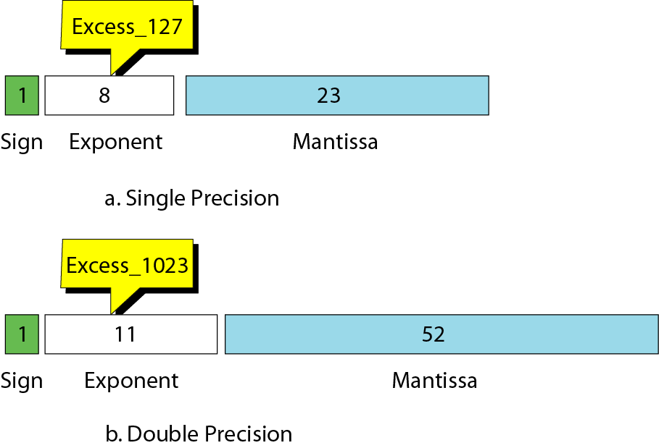
Figure 3-8
IEEE standards for floating-point representation
32-bit IEEE format
64-bit IEEE format

Slide 92
Single-precision Representation---表示
1. Store the sign as 0 (positive) or 1 (negative).
2.Store the exponent as Excess_127（+127）.
3.Store the mantissa as an unsigned integer.

Slide 93
Example 19
Show the representation of the normalized number + 2⁶ X 1.01000111001
Solution
The sign is positive. The Excess_127 representation of the exponent is 133. You add extra 0s on the right to make it 23 bits. The number in memory is stored as:
0 10000101 01000111001000000000000
sign exponent mantissa

Slide 94
Table 3.11 Example of floating-point representation
Number
------------
-2² x 1.11000011
+2⁻⁶ x 1.11001
-2⁻³ x 1.110011
Sign
----
1
0
1
Exponent
-----------
10000001
01111001
01111100
Mantissa
-------------------------------
11000011000000000000000
11001000000000000000000
11001100000000000000000

Slide 95
Floating-Point Interpretation for Single precision---翻译
1. Use the leftmost bit as the sign.
2.Change the next 8 bits to decimal and subtract 127 from it. This is the exponent.
3.Add 1 and a decimal point to the next 23 bits. You can ignore any extra 0s at the right.
4.Move the decimal point to the correct position using the value of the exponent.
5. Change the integer part to decimal.
6.Change the fraction part to decimal.
7.Combine the integer and the fraction part.

Slide 96
Example 20
Interpret the following 32-bit floating-point number
1 01111100 11001100000000000000000
Solution
The sign is negative. The exponent is –3 (124 – 127). The number after normalization is
-2⁻³ × 1.110011

Slide 97
Exam
1.Change the -102 decimal number to 8-bit sign-and-magnitude integer, one’s complement integer, two’s complement integer.
2. Change the two’s complement numbers 10000101 and 01010001 to decimal number.
3. Show the number 2⁻² x 101.110011 in 32-bit IEEE format.
4. Show the +7.1875 in 32-bit IEEE format.

Slide 98
为什么用补码表示？
假设当前时针指向11点，而准确时间是8点，调整时间可有以下两种拨法：
一种是倒拨3小时，即：11-3=8
另一种是顺拨9小时：11+9=12+8=8
在以模为12的系统中，加9和减3效果是一样的，因此凡是减3运算，都可以用加9来代替。对“模”12而言，9和3互为补数（二者相加等于模）。所以我们可以得出一个结论，即在有模的计量系统中，减一个数等于加上它的补数，从而实现将减法运算转化为加法运算的目的。

Slide 99
# 按以上理论，减一个数等于加上它的补数，所以
5 - 3
# 等价于
5 + (16 - 3) // 算术运算单元将减法转化为加法
# 用二进制表示则为：
0101 + (10000 - 0011)
# 等价于
0101 + ((1 + 1111) - 0011)
# 等价于
0101 + (1 + (1111 - 0011))
# 等价于
0101 + (1 + 1100) // 括号内是3（0011）的反码+1，正是补码的定义
# 等价于
0101 + 1101
# 所以从这里可以得到
-3 = 1101
# 即 `-3` 在计算机中的二进制表示为 `1101`，正是“ -3 的正值 3（`0011`）的补码（`1101`）”。
# 最后一步 0101 + 1101 等于
10010

